Slide 1
Paired Verbal Fluency
3 rounds
1st: Partner A then Partner B
15 seconds each
2nd: Partner B then Partner A
30 seconds each
3rd: Partner A then Partner B
60 seconds each
Partner A
Partner B

Slide 2
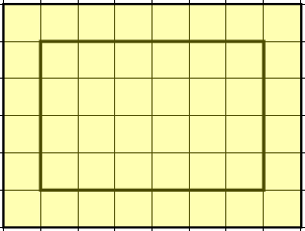
Explain to your partner how you might find the area of this figure.
Partner A – 15 seconds
Partner B – 15 seconds

Slide 3
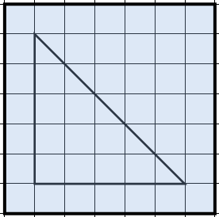
Explain to your partner how you might find the area of this figure.
Partner B – 30 seconds
Partner A – 30 seconds

Slide 4
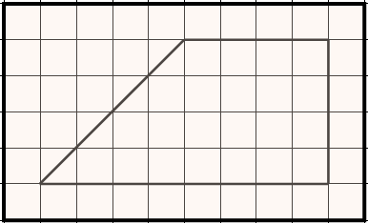
Explain to your partner how you might find the area of this figure.
Partner A – 60 seconds
Partner B – 60 seconds

Slide 5
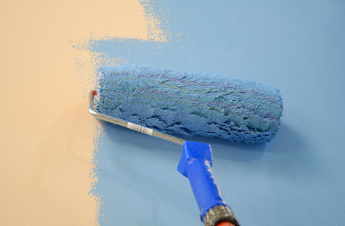
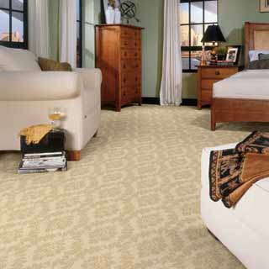
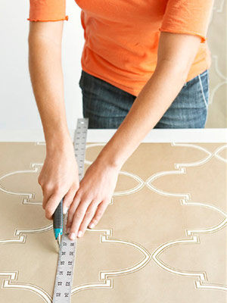
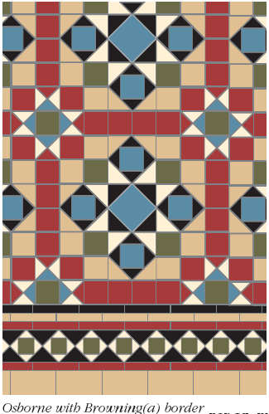
AREA

Slide 6
